Slide 1
SharePoint APIs
REST & OData

Slide 3
How to View This Presentation
To switch to Notes Page view:
While in edit mode, click the View tab within the ribbon, and then click Notes Page
To navigate through notes, use the Page Up and Page Down keys
Zoom in or zoom out, if required
In the Notes Page view, you can:
Read any supporting text—now or after the delivery
Add notes to your copy of the presentation, if required
Take the presentation files home with you

Slide 4
Overview
What are REST & OData services
In this Lesson
REST URL syntax
How to use OData refiners

Slide 5
Objectives
Learn what the REST & OData services are
Get familiar with how to use them
Know when to use it for your customizations
Discover the structure of REST URLs

Slide 6
What are REST & OData services
Can be used from any platform and any language
Allows use of OAuth for authentication and authorization
Data returned in JSON or XML
Much easier to use and test than SOAP-based Web service
Higher productivity when using JavaScript and jQuery because of its native support
Notes:
The major benefit of REST and OData is that it can be used from any platform and any language. It still allows the use of OAuth as the underlying authentication protocol. The data is returned in a generic JSON or XML format. This makes it ideal to use on non .NET platforms where CSOM can’t be leveraged. Even on .NET platforms a developer might opt to use REST so to leverage the easy syntax and standardized way of interacting with REST services.

Slide 7
Diving into the Protocol
What is REST
HTTP Verbs
Examples
Architecture
URI Structure
What is OData
Notes:
The following slides will dive deeper into what REST and OData are and will cover the subtopics shown on this slide.

Slide 8
What is REST?
REST (Representational State Transfer) is a style of software architecture for distributed systems such as the World Wide Web
A RESTful web API is a web service implemented using HTTP and the principles of REST
Each REST command is an HTTP POST, GET, PUT, or DELETE request where the specifics of the command are encapsulated within the URL
Notes:
Over the last few years REST-based Web services have become increasing popular through the IT industry and particularly within Microsoft. REST-based Web services are much easier to use than SOAP-based Web service and therefore lower the barrier of entry to different types of potential clients. REST-based Web services are also much easier to call from JavaScript code especially when using the jQuery library.
Complete basic operations using REST: https://docs.microsoft.com/en-us/sharepoint/dev/sp-add-ins/complete-basic-operations-using-sharepoint-rest-endpoints
Microsoft community driven guidelines for REST development: http://dev.office.com/blogs/rest-api-design-guidelines

Slide 9
What is OData?
OData (Open Data Protocol) is a data access protocol designed to provide standard CRUDQ access to a data source via a website
OData requests use the REST model
Added to the URL syntax with a dollar sign followed by an instruction
$filter=Title -eq ‘First item’
$orderby=Title
$top=2
Notes:
OData stands for the Open Data Protocol and is a layer on top of REST and provides for filtering and updating data over REST. It uses normal HTTP verbs to send instructions to a SharePoint server on what it wants to accomplish.
More information can be found on: http://www.odata.org/
Use this intro https://www.youtube.com/watch?v=wH5TUwzlaWI

Slide 10
Knowledge Check
REST (Representational State Transfer) is a style of software architecture for distributed systems such as the World Wide Web
A RESTful web API is a web service implemented using HTTP and the principles of REST
What does NOT describe a REST API?
REST only works within Microsoft .NET environments
What applies to OData?
OData (Open Data Protocol) is a data access protocol designed to provide standard CRUDQ access to a data source via a website
OData requests use the REST model
The $ sign is being used to add instructions to the URL
Notes:
Third option
All three apply to OData and are correct

Slide 11
Knowledge Check
REST (Representational State Transfer) is a style of software architecture for distributed systems such as the World Wide Web
A RESTful web API is a web service implemented using HTTP and the principles of REST
What does NOT describe a REST API?
REST only works within Microsoft .NET environments
What applies to OData?
OData (Open Data Protocol) is a data access protocol designed to provide standard CRUDQ access to a data source via a website
OData requests use the REST model
The $ sign is being used to add instructions to the URL

Slide 12
APIs Introduced in SharePoint 2013
The following functionality can now be leveraged using CSOM, PnP JS and REST
User Profiles
Search
Taxonomy
Feeds
Publishing
Sharing
Workflow
E-Discovery
IRM
Analytics
Business Data
Document Sets
Notes:
This slide above lists areas in the SharePoint 2016 & 2019 remote API that are accessible through either CSOM and/or REST. These APIs were introduced in SharePoint 2013. This is a welcome change from 2010 because until then most of this functionality had been only available through server-side APIs.
You can also see adding this remote access is very important to the new Add-In model where developers can no longer access server side code.

Slide 13
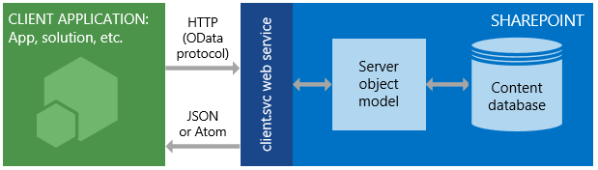
REST/OData Services Architecture
Notes:
This slide gives a visual representation of how the interaction between a client application living outside of SharePoint and SharePoint takes place when using REST. As you can see the requests go through Client.svc on the SharePoint server which has access to the Server Side Object Model (SSOM) which on its turn has access to all the data it needs, i.e. the content database. When using CSOM or JSOM the flow would be identical, only then the underlying service will not make use of REST/OData to request data, but will use XML communication both towards and from SharePoint and on the client side to the deserialization of the XML into the objects exposed in JSOM and CSOM.

Slide 14
REST/OData Uri Sample
https://dev.contoso.local/sites/team/_api/web/lists/getbytitle('Documents')/items(3)?$select=Title,FileRef
https://dev.contoso.local/sites/team/_api/
web/lists/getbytitle(‘Documents’)/items(3)
?$select=Title,FileRef
Service Root URL
Resource Path (REST)
Query String Options (OData)
Notes:
Most client object model APIs have, or are planned to have, a corresponding REST endpoint; whenever possible, the URI for these REST endpoints closely mimics the structure of the API signature. In some cases, however, the endpoint URI must be adapted to account for REST or OData conventions. This section describes general guidelines for determining REST endpoint URIs from the signature of the corresponding client object model API.
Figure displays the general syntax structure of SharePoint REST URIs. The following sections discuss each of the main segments, and several other URI structure alternatives, in detail.
Note that the (3) here in the URL means return me the item with the primary identifier 3, which for SharePoint would be the ID column. If you would delete the list item with ID 3, it will return “Item does not exist”, so they don’t shift once items get deleted but stick to the ID they have been assigned when the list item was created.
The REST endpoints deviate from this syntax structure in two major areas:
In the case of a REST endpoint where the corresponding client object model method requires that complex types are passed as parameters, the REST endpoint may deviate from this syntax construction to account for REST limitations.
REST endpoints deviate from this syntax structure for URIs that are specified for static methods and properties.
See: https://docs.microsoft.com/en-us/sharepoint/dev/sp-add-ins/use-odata-query-operations-in-sharepoint-rest-requests

Slide 15
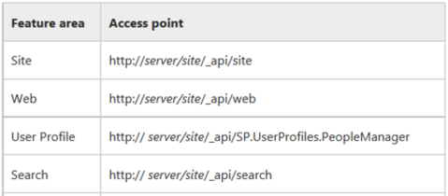
Other Base REST Uris
Notes:
Here you see the REST endpoint base uris that can be used to interact with different components of SharePoint. Notice the logical buildup of the URL. There is no definitive list of available REST endpoints, unfortunately.
For more information, see: http://msdn.microsoft.com/en-us/library/dn292556%28v=office.15%29.aspx and http://msdn.microsoft.com/en-us/library/jj860569%28v=office.15%29.aspx

Slide 16
OData Filters & Refiners
The OData $format query option is not supported by SharePoint 2013 & 2016
Query Option | Description
$expand | Expand related data inline with the results, e.g. Categories/$expand=Products would expand Product data inline with each Category entry.
$filter | A Boolean expression for whether a particular entry should be included in the feed, e.g. Categories?$filter=CategoryName eq 'Produce'. The Query Expression section describes OData expressions.
$orderby | One or more comma-separated expressions with an optional “asc” (the default) or “desc” depending on the order you’d like the values sorted, e.g. Categories?$orderby=CategoryName desc.
$select | Limit the properties on each entry to just those requested, e.g. Categories?$select=CategoryName,Description. Case sensitive!
$skip | How many entries you’d like to skip, e.g. Categories?$skip=4.
$top | Return entries from the top of the feed, e.g. Categories?$top=4
Notes:
This slide shows an overview of the OData filters and refiners that can be used with SharePoint 2016. Use this for reference.
For more information on OData, see http://msdn.microsoft.com/en-us/library/ff478141.aspx
For an overview of supported commands with OData and SharePoint 2016, see: http://msdn.microsoft.com/en-us/library/fp142385
Discuss importance of $select option on performance to keep data sent over wire as small as possible.

Slide 17
Specifying the Return Type
Via HTTP Accept header specify format for results
 | SP2013 | SP2016 SP2019 | SPO
Accept: application/json;odata=verbose | Yes | Yes | Yes
Accept: application/json;odata=minimalmetadata | No | Yes | Yes
Accept: application/json;odata=nometadata | No | Yes | Yes
Accept: application/atom+xml | Yes | Yes | Yes
Notes:
Since August 2014 JSON light is supported by the SharePoint REST API in SharePoint Online: http://blogs.office.com/2014/08/13/json-light-support-rest-sharepoint-api-released/
It has also been shipped to SharePoint 2016 & 2019 on premises. SharePoint 2013 has never been updated to support it. This was last verified against the September 2017 CU for SharePoint 2013. That means that for SharePoint 2017 you can only use Accept: application/json;odata=verbose which includes a lot of overhead data.
Depending on the value specified next to OData, a different payload is returned.

Slide 18
HTTP Verbs
HTTP POST
Creates an item
HTTP GET
Read data
HTTP DELETE
Delete an item
HTTP PUT
Update an item, reset all fields that have not been specified to their default values
HTTP MERGE
Update an item, only update the fields that have been specified, leave the rest as they are
Alternatively if firewalls only allow HTTP GET/POST, use X-HTTP-Method header in a HTTP POST
I.e. X-HTTP-Method: MERGE
Notes:
For POST operations, any properties that are not required are set to their default values. If you attempt to set a read-only property as part of a POST operation, the service returns an exception.
Use PUT , PATCH, and MERGE operations to update existing SharePoint objects. Any service endpoint that represents an object property set operation supports both PUT requests and MERGE requests. For MERGE requests, setting properties is optional; any properties that you do not explicitly set retain their current property. For PUT commands, however, any properties you do not explicitly set are set to their default properties. In addition, if you do not specify all settable properties in object updates when using HTTP PUT commands, the REST service returns an exception.
Use the HTTP DELETE command against the specific endpoint URL to delete the SharePoint object represented by that endpoint. In the case of recyclable objects, such as lists, files, and list items, this results in a Recycle operation.
Some firewalls that are rather strict only allow for HTTP GET and HTTP POST requests to pass since these are most common. In that case you revert to doing a HTTP POST request in which you add a header X-HTTP-Method in which you specify the actual command you wish to execute (DELETE/PUT/MERGE).

Slide 19
Knowledge Check
Yes
Can REST be used for CRUDQ Operations
What 2 examples are NOT HTTP verbs?
No
HTTP POST
HTTP GET
HTTP DELETE
HTTP PULL
HTTP FETCH

Slide 20
Knowledge Check
Yes
Can REST be used for CRUDQ Operations
What 2 examples are NOT HTTP verbs?
No
HTTP POST
HTTP GET
HTTP DELETE
HTTP PULL
HTTP FETCH

Slide 21
Changing REST/OData Data
Done using a HTTP POST/DELETE/PUT/MERGE
Requires an X-RequestDigest for security purposes
Allows usage of the If-Match header for concurrency control
Notes:
There are a few things to keep in mind when wanting to update data using REST. One is that as shown on the previous slide, you need to use a HTTP POST, DELETE, PUT or MERGE. The second is that you need to post a RequestDigest. This is required so the SharePoint server has a way to validate that the request originated from a previous interaction with SharePoint. This is an attempt to prevent against cross site scripting. More on this in the next slides. Another thing to be aware of is that there’s also support for concurrency control. Meaning, if multiple people try to update for example the same list item, which data wins? The first or the last update? This can be arranged through the If-Match header. More on this in the next slides.

Slide 22
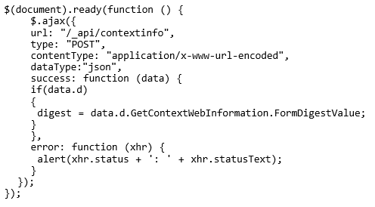
X-RequestDigest
Changing data always requires the X-RequestDigest header to be sent in the request
When called from SharePoint
Use $("#__REQUESTDIGEST").val()
When called outside SharePoint
Place an empty POST call to /_api/contextinfo
Or use the _vti_bin/sites.asmx method
GetUpdatedFormDigestInformation
Default Digest lifetime is 30 minutes
Notes:
Whenever you want to change something in SharePoint via REST, it is mandatory to add an X-RequestDigest header in your REST call towards SharePoint. This is a security measure built into SharePoint to verify that the request that lead to an update originated in SharePoint. While this isn’t always the case anymore with REST as a request can perfectly originate outside of SharePoint, this still is a requirement. If your call does originate from SharePoint, you can make use of the hidden form field with the ID __REQUESTDIGEST which SharePoint automatically places in each page it serves. So not only in pages of HostWebs, but also in all pages in AppWebs. The jQuery syntax shown on this slide shows how this value can be retrieved and used.
If your call does originate outside of SharePoint, you have two options. One is to place a HTTP POST call to /_api/contextinfo with an empty body. This will return a valid RequestDigest value that you can use. Another, less preferred, method is to use the _vti_bin/sites.asmx. It exposes a method GetUpdatedFormDigestInformation which will also return a RequestDigest that you can use in your REST call.
Note that the default request digest lifetime is 30 minutes only. So be sure to write your code so it can handle requesting a new request digest when necessary.
You can use a call to the following method in JavaScript when being on a classic SharePoint page to ensure the Form Digest on the page is valid and can be used along with your request:
UpdateFormDigest(_spPageContextInfo.webServerRelativeUrl, _spFormDigestRefreshInterval);

Slide 23
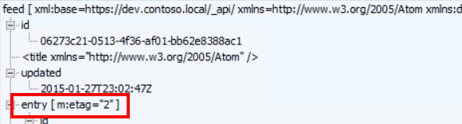
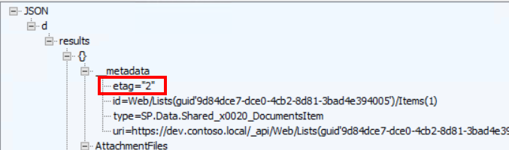
Concurrency control
Possible via If-Match header
OData standard
ETag number != SharePoint version number
Specify the exact same value as the Etag and between quotes, i.e. If-Match: “1”
Use If-Match: * to disable concurrency control
Only usable with SharePoint lists and list items
Notes:
Concurrency control in the REST API in SharePoint is provided through the use of an If-Match header with what is called an ETag number. This is an OData standard way of keeping concurrency in place. It allows for handling of situations where, for example, two users are using your Add-In. Both have retrieved the same list item and start updating it. User A executes an update request for the data in the list item. Shortly thereafter user B does the same while user A already caused an update of the data.
If the If-Match header provides the same numeric value as was sent along with the list item data when requesting it and the list item has not been changed in the meantime, the data gets updated successfully.
However in this scenario let’s say the original list item had an ETag value of 5 when it was requested by user A and B, when user A updated it, it specified If-Match: 5 in the header which matched the actual version so that update succeeded. When user B did the update, he also specified ETag 5 in his request but this got denied by the server since the ETag now became 6 due to the update of user A. So now the first user updating the item wins.
This behavior only works for SharePoint lists and list items. Not for all other data that can be interacted with through REST in SharePoint.
Last thing to note is that the ETag number is an internal versioning system which is in no way related to the SharePoint versioning that can be turned on for list items. So it is not required to have versioning on a library enabled for this to work and there is no relationship whatsoever between the version number shown in SharePoint and the ETag version applied to the list item.
The screencaptures at the bottom show how an etag value is provided in an ATOM/XML response and a JSON response when requesting a list item.

Slide 24
Examples of Querying Data
Retrieving all list items in a specific list
https://dev.contoso.local/_api/web/lists/getbytitle('documents')/items
Retrieving the first item in a specific list
https://dev.contoso.local/_api/web/lists/getbytitle('documents')/items(1)
Retrieve all lists in a web, but only the title and sort them alphabetically
https://dev.contoso.local/_api/web/lists?$select=Title&$orderby=Title
Retrieving just the title of the web
https://dev.contoso.local/_api/web/title
Retrieving the filename of all documents in the Documents library of which the filename starts with ‘Step’
https://dev.contoso.local/_api/web/lists/getbytitle('Documents')/items?$select=FileLeafRef&$filter=startswith(FileLeafRef, 'Step’)
Executing a CAML query
https://dev.contoso.local/_api/web/lists/getbytitle('Documents’)/GetItems(query=<View>...</View>)
Notes:
This slide shows some sample REST queries that can be executed in order to retrieve data.
Animation is configured on this slide so that it can be used as an interactive activity with the class. For example:
Click to start slide and click to show question 1: “who wants to tell us the syntax for a REST call that will retrieve all items in a specific list?”
Click to show and explain answer
Repeat steps 1 & 2
Alternatively, the entire slide can be exposed and discussed if needed.

Slide 25
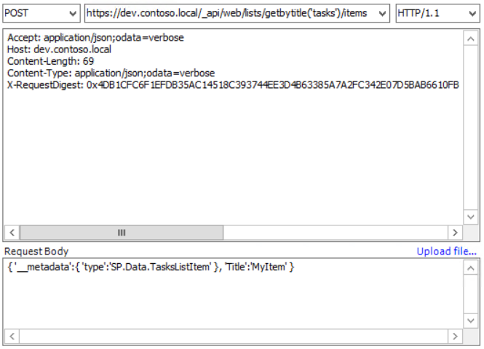
Examples of Creating Data
Create a new list item in a list called Tasks
Notice use of HTTP POST
Notice the Accept and Content-Type headers
Notice the mandatory X-RequestDigest
The Type in the POST Body consists out of
SP.Data.<listname>ListItem
This request will return a HTTP 201 Created when successful
Notes:
Here you see a sample REST query that will create a list item in an already existing list named “Tasks” in SharePoint and set the list item title field to MyItem
If you would rename the list, the <listname> will NOT change, so the part in the __metadata will remain the original name.
Another opportunity to ask the class “what is this information showing us?” and the information can be revealed after or during discussion.
To demonstrate this in Fiddler, use a HTTP POST to: Host: dev.contoso.local
Accept: application/json;odata=nometadata
Content-Length: 69
Content-Type: application/json;odata=verbose
X-RequestDigest: 0x5F9247B0011B8E76B1354C94B88BDCE6AF0AF63B4DA2B9D10254D21D8ED4196CBB6060D815A6B67260A7287D7AEB72593DED71BB6C1DC4CBAA48505CABC60FE5,11 Sep 2019 08:37:12 -0000
{ '__metadata': { 'type': 'SP.Data.TasksListItem' }, 'Title': 'Test'}

Slide 26
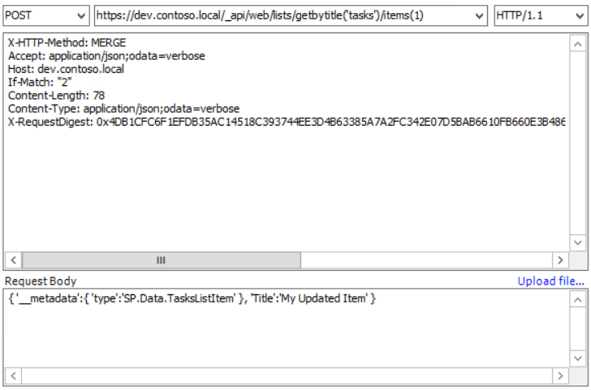
Examples of Updating Data
Updates an existing list item in a list called Tasks
Notice use of HTTP POST overriding the intended use to MERGE using the X-HTTP-Method header
Notice the Accept and Content-Type headers
Notice the mandatory X-RequestDigest
Notice If-Match header
The Type in the POST Body consists out of
SP.Data.<listname>ListItem
This request will return a HTTP 204 No Content when successful
Notes:
Here you see a sample REST query that will update an already existing list item in a list called Tasks in SharePoint and updates its title field

Slide 27
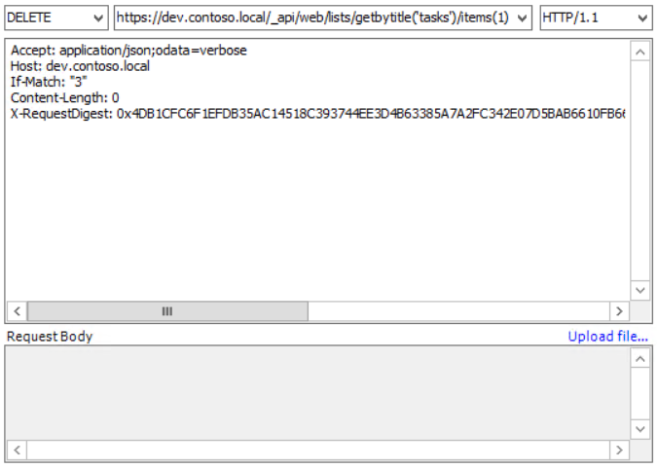
Examples of Deleting data
Deletes a list item from a list called Tasks
Notice it using a HTTP DELETE
Notice the mandatory X-RequestDigest
Notice the If-Match header
This request will return a HTTP 200 OK when successful
Notes:
Here you see a sample REST query that will delete an already existing list item from a list called Tasks in SharePoint

Slide 28
Knowledge Check
Can you use REST and OData from a website running PHP
What is the OData operator to limit the properties that are returned
If firewalls won’t allow you to use HTTP DELETE, what’s the alternative
Yes
$select
Use HTTP POST and add the “X-HTTP-Method: DELETE” header to your request
When would you use a RequestDigest
When sending a request that would change data in SharePoint

Slide 29
Lesson Summary
REST/OData can be used for CRUD Operations
The Uri string is used to interact with SharePoint data
HTTP GET, POST, DELETE, PUT, and MERGE are common calls; those changing data will require X-RequestDigest in the header

Slide 30
Questions?

Slide 31
Lab: Working with REST
In this lab, you will learn how to access CSOM through the new REST API. You will write code-behind site pages using JavaScript, which leverages the AJAX capabilities of the jQuery library. You will also learn how to use the jsRender library and templates to format JSON results into HTML for display on a page.
Time estimation: 45 minutes
Notes:
Lab content can be found under “Lab - Working with REST”

Slide 32
Provider and Endpoint Examples
Search REST
https://dev.contoso.local/_api/search/query?querytext= ‘Microsoft’

